Slide 1
Income Class Prediction through Expenditure Allocation
Genesis Adam D. Mendoza

Slide 2
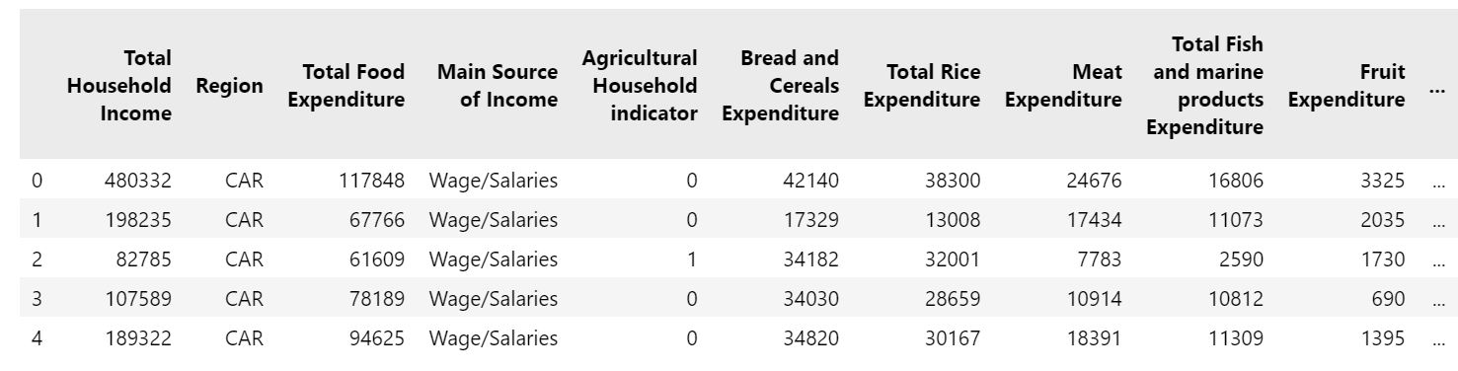
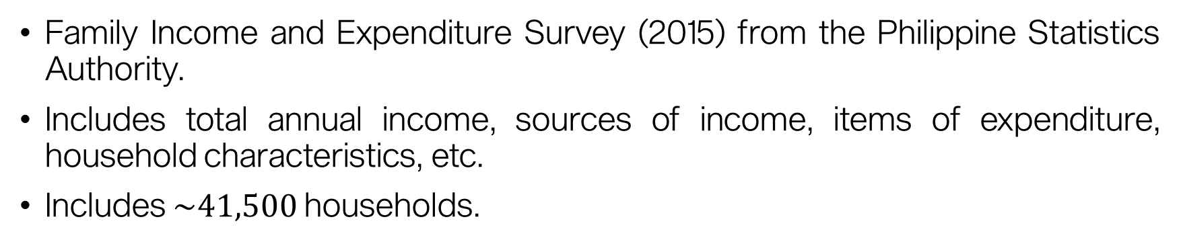
About the data
Family Income and Expenditure Survey (2015) from the Philippine Statistics Authority.
Includes total annual income, sources of income, items of expenditure, household characteristics, etc.
Includes $\sim 41,500$ households.

Slide 3
About the data
'Total Household Income', 'Region', 'Total Food Expenditure', 'Main Source of Income', 'Agricultural Household indicator', 'Bread and Cereals Expenditure', 'Total Rice Expenditure', 'Meat Expenditure', 'Total Fish and marine products Expenditure', 'Fruit Expenditure', 'Vegetables Expenditure', 'Restaurant and hotels Expenditure', 'Alcoholic Beverages Expenditure', 'Tobacco Expenditure', 'Clothing, Footwear and Other Wear Expenditure', 'Housing and water Expenditure', 'Imputed House Rental Value', 'Medical Care Expenditure', 'Transportation Expenditure', 'Communication Expenditure', 'Education Expenditure', 'Miscellaneous Goods and Services Expenditure', 'Special Occasions Expenditure', 'Crop Farming and Gardening expenses', 'Total Income from Entrepreneurial Acitivites', 'Household Head Sex', 'Household Head Age', 'Household Head Marital Status', 'Household Head Highest Grade Completed', 'Household Head Job or Business Indicator', 'Household Head Occupation', 'Household Head Class of Worker', 'Type of Household', 'Total Number of Family members', 'Members with age less than 5 year old', 'Members with age 5 - 17 years old', 'Total number of family members employed', 'Type of Building/House', 'Type of Roof', 'Type of Walls', 'House Floor Area', 'House Age', 'Number of bedrooms', 'Tenure Status', 'Toilet Facilities', 'Electricity', 'Main Source of Water Supply', 'Number of Television', 'Number of CD/VCD/DVD', 'Number of Component/Stereo set', 'Number of Refrigerator/Freezer', 'Number of Washing Machine', 'Number of Airconditioner', 'Number of Car, Jeep, Van', 'Number of Landline/wireless telephones', 'Number of Cellular phone', 'Number of Personal Computer', 'Number of Stove with Oven/Gas Range', 'Number of Motorized Banca', 'Number of Motorcycle/Tricycle'

Slide 4
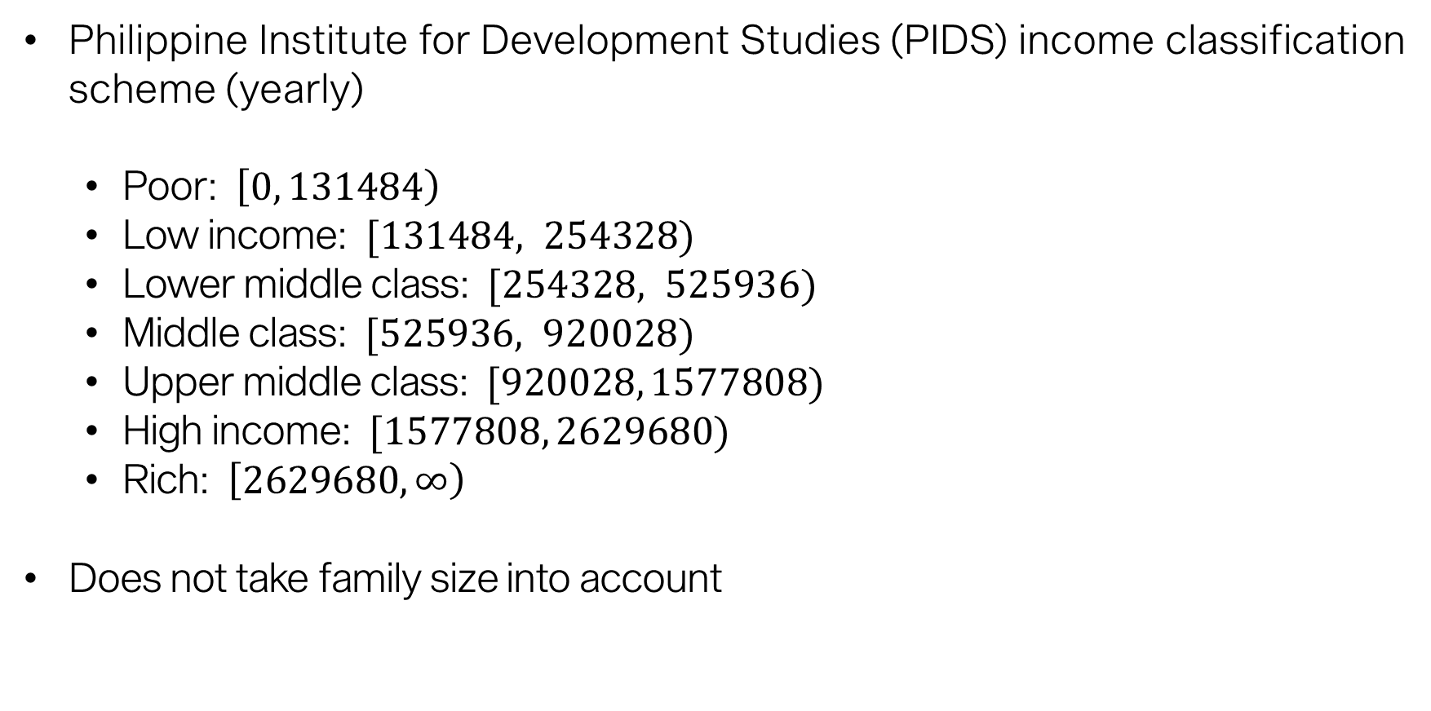
Income classification
Philippine Institute for Development Studies (PIDS) income classification scheme (yearly)
Poor: $\left[0, 131484\right)$
Low income: $[131484, 254328)$
Lower middle class: $[254328, 525936)$
Middle class: $[525936, 920028)$
Upper middle class: $[920028, 1577808)$
High income: $[1577808, 2629680)$
Rich: $\left[2629680,∞\right)$
Does not take family size into account

Slide 5
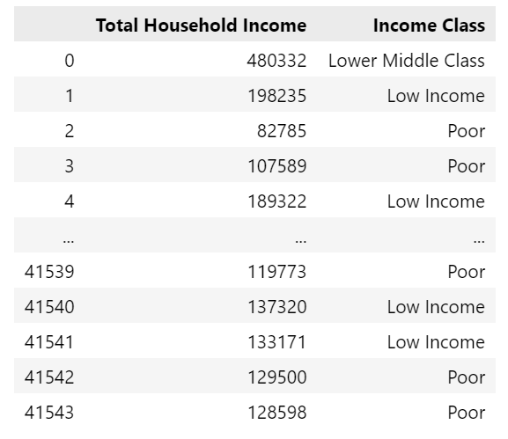
Income classification

Slide 6
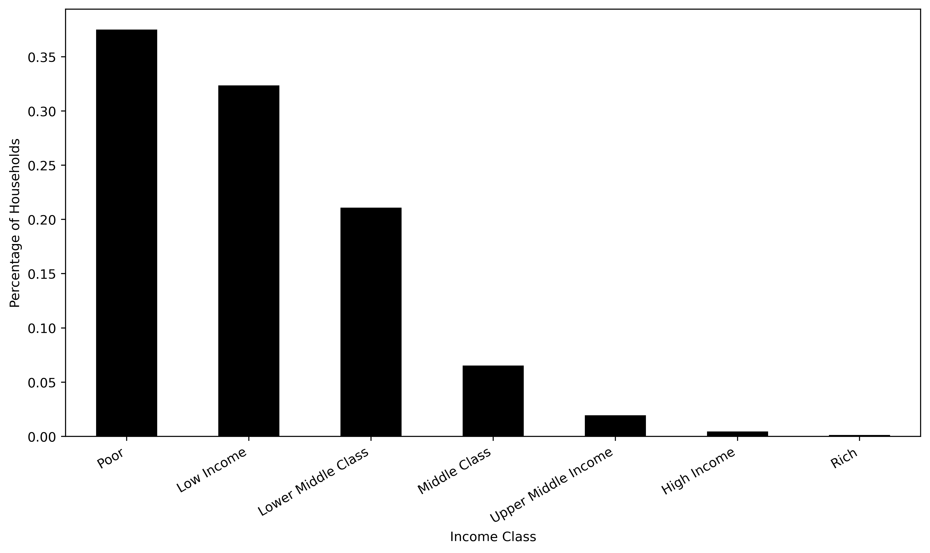
Income classification
Majority of Filipinos are poor.
Philippine Institute for Development Studies (PIDS) income classification scheme

Slide 7
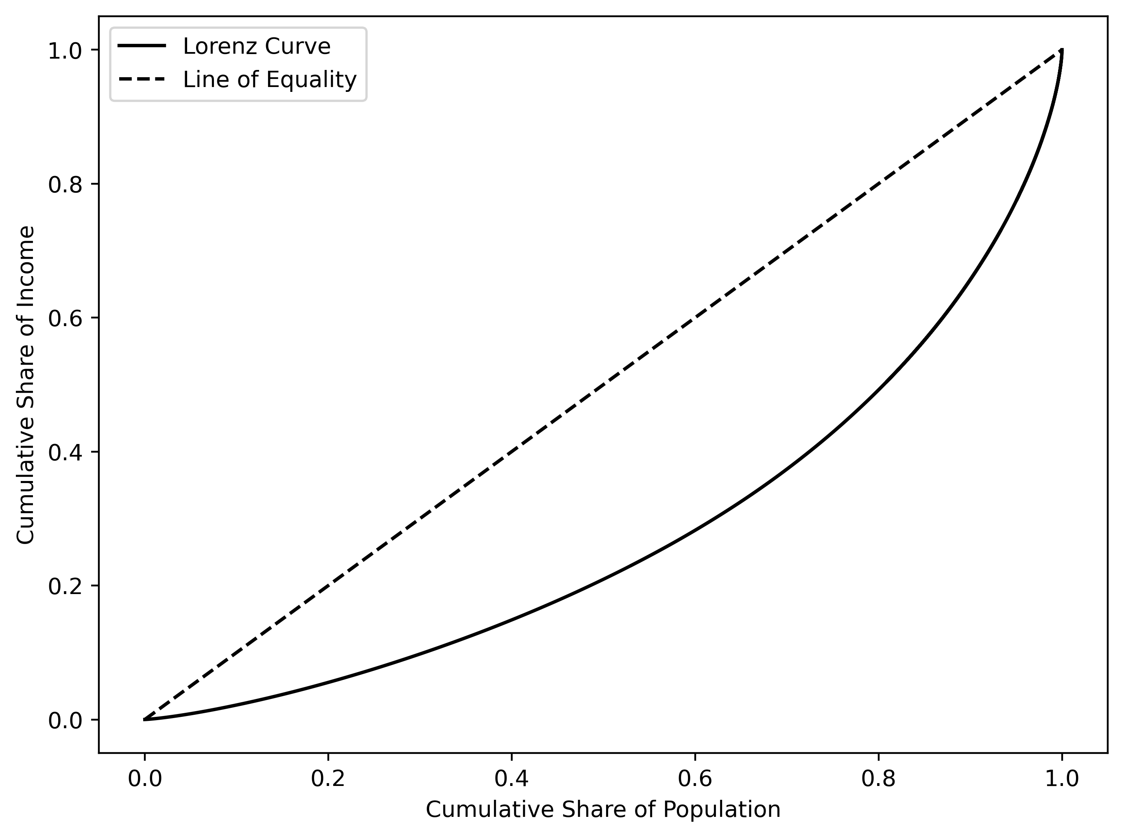
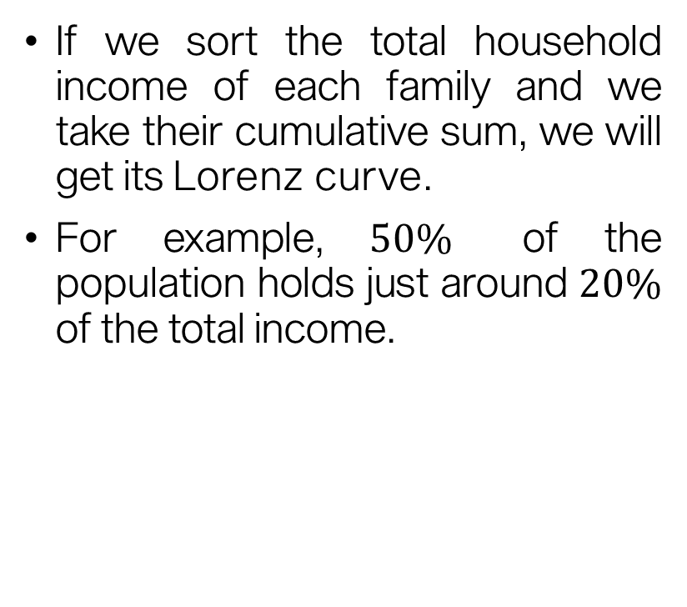
Income inequality
If we sort the total household income of each family and we take their cumulative sum, we will get its Lorenz curve.
For example, $50\%$ of the population holds just around $20\%$ of the total income.

Slide 8
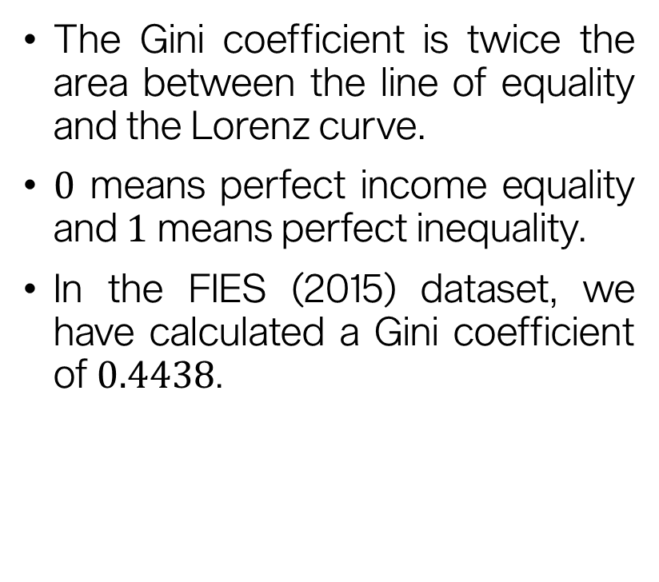
Income inequality
The Gini coefficient is twice the area between the line of equality and the Lorenz curve.
$0$ means perfect income equality and $1$ means perfect inequality.
In the FIES (2015) dataset, we have calculated a Gini coefficient of $0.4438$.

Slide 9
Income inequality
Caveat
We are not proposing a solution to the problem of income inequality.
Income inequality is complex (Estudillo, 1997):
Rising proportion of urban households
Age distribution
Increasing number of highly educated households
Wage rate inequality
Main question:
How does income inequality affect the spending behavior of different income classes?
Estudillo, J. P. (1997). Income inequality in the Philippines, 1961–91. The Developing Economies, 35(1), 68-95.

Slide 10
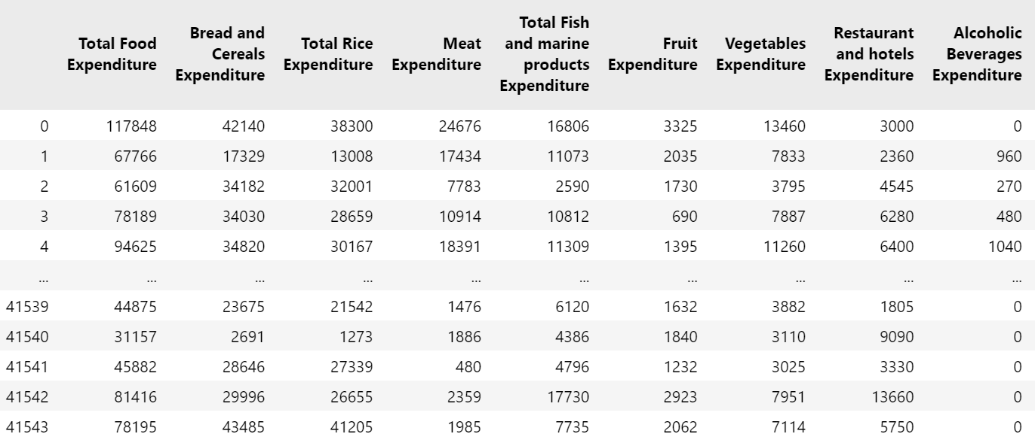
Expenditure allocation

Slide 11
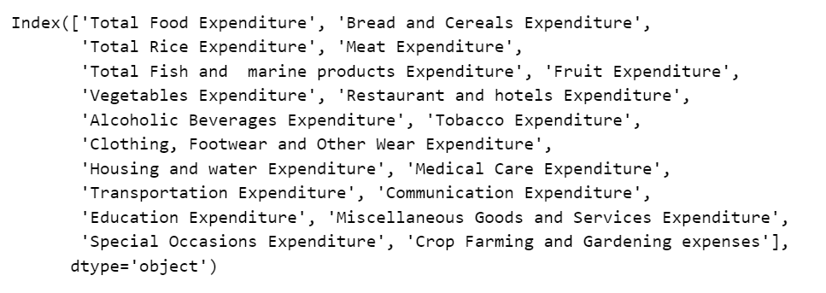
Expenditure allocation

Slide 12
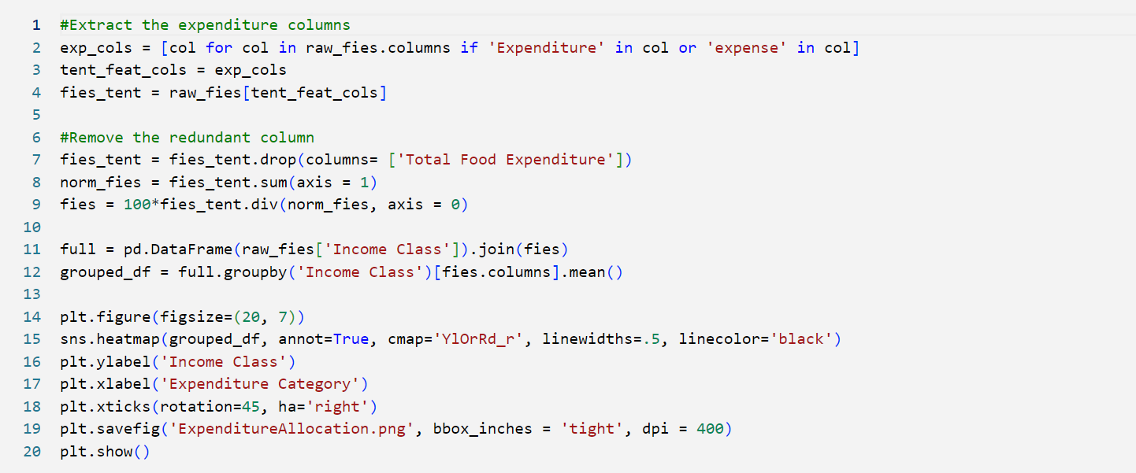
Expenditure allocation
What percentage of the total expenditure is allocated for each expenditure item?

Slide 13
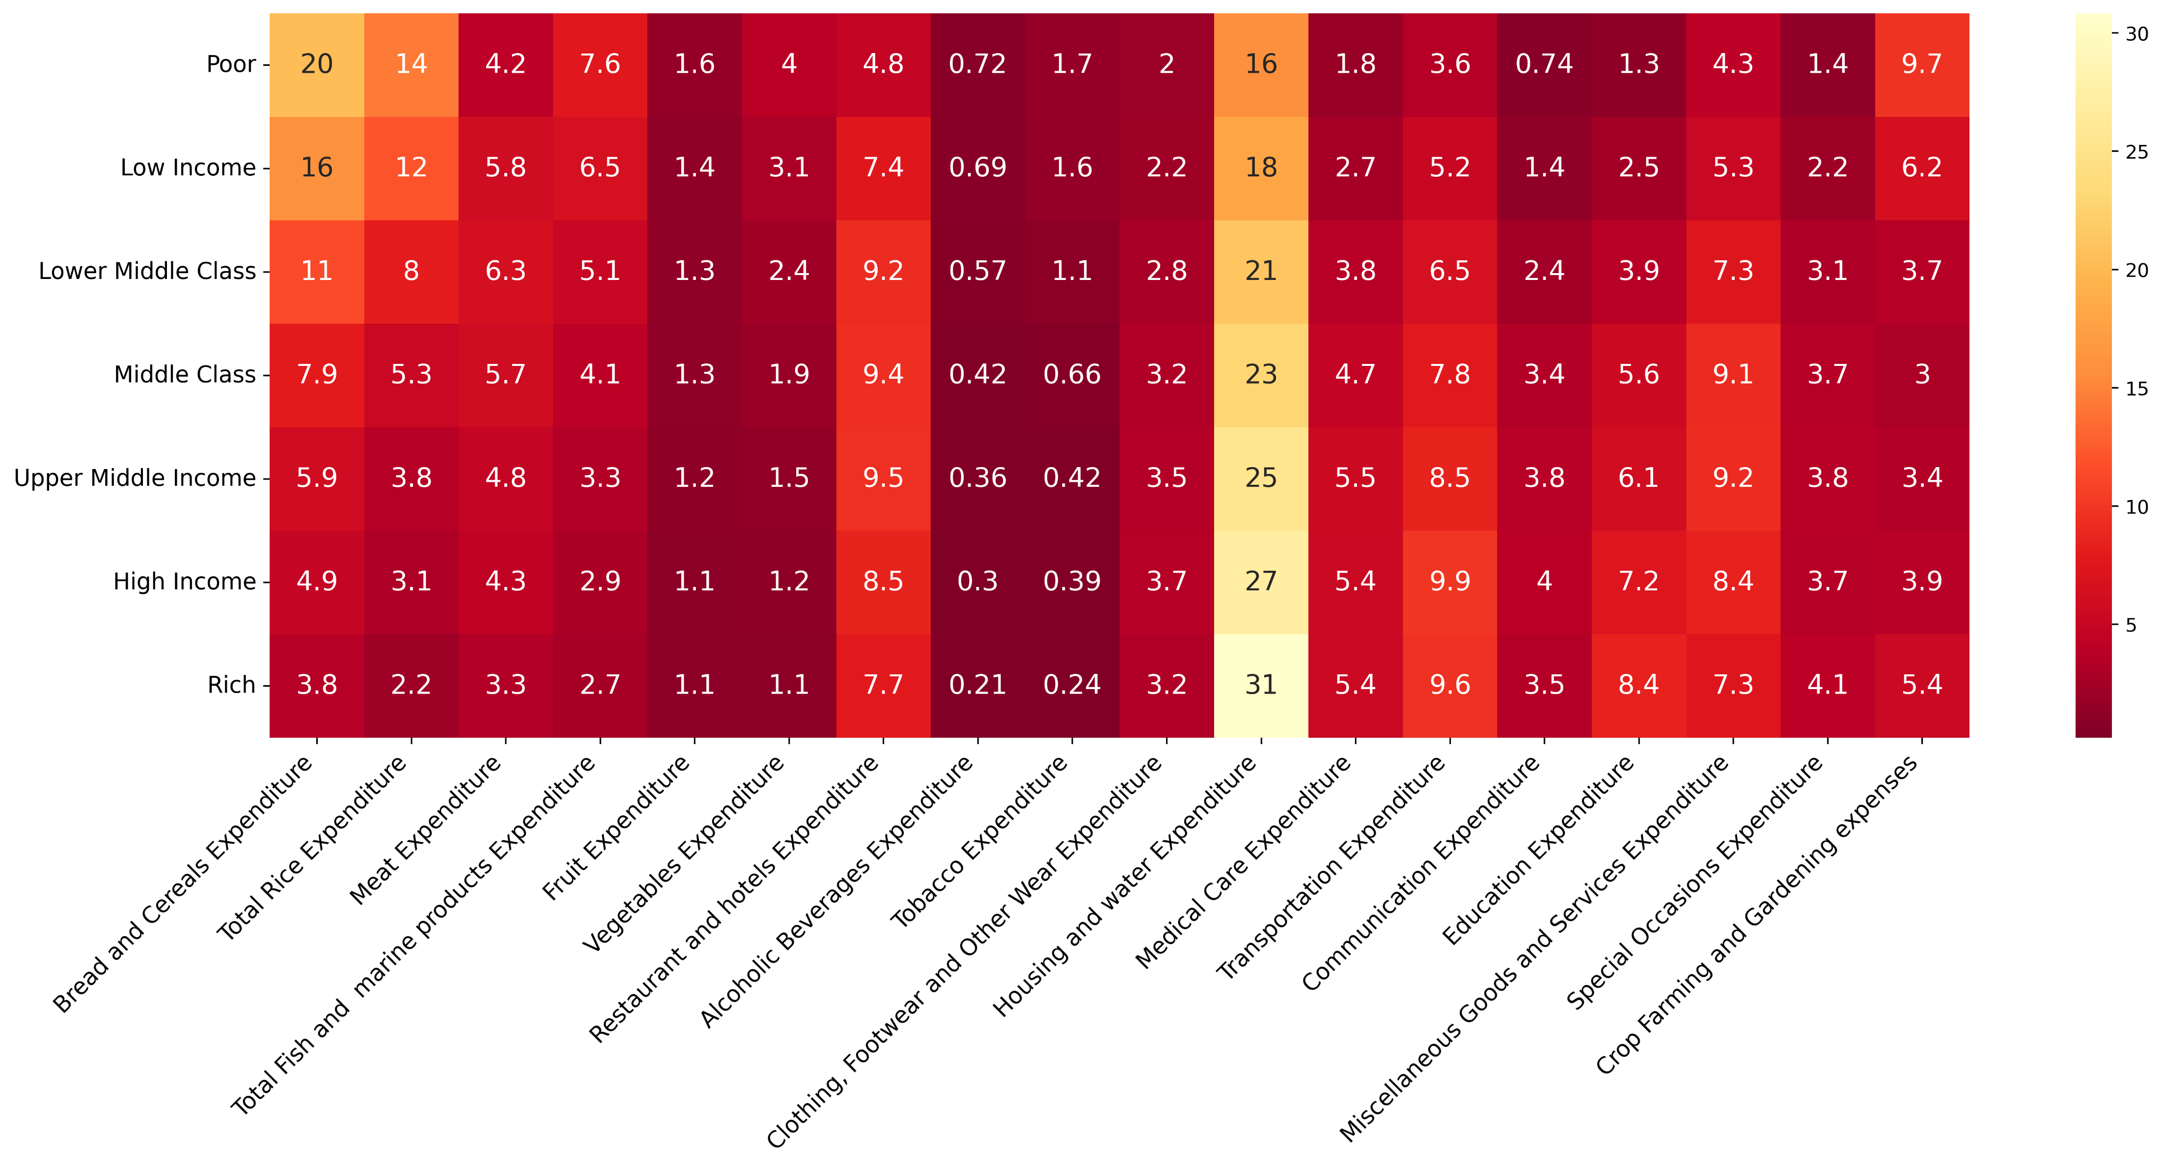
What percentage of the total expenditure is allocated for each expenditure item?

Slide 14
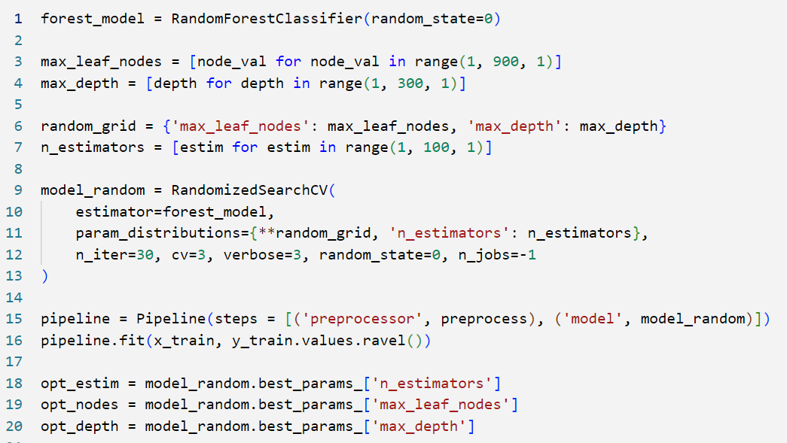
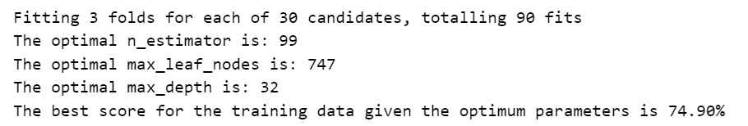
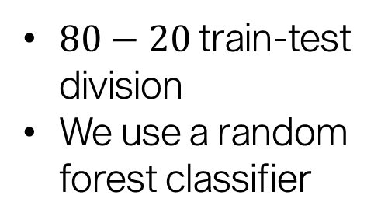
Prediction Model
$80−20$ train-test division
We use a random forest classifier

Slide 15
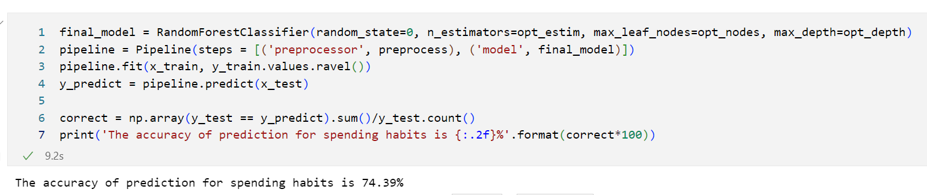
Prediction Model

Slide 16
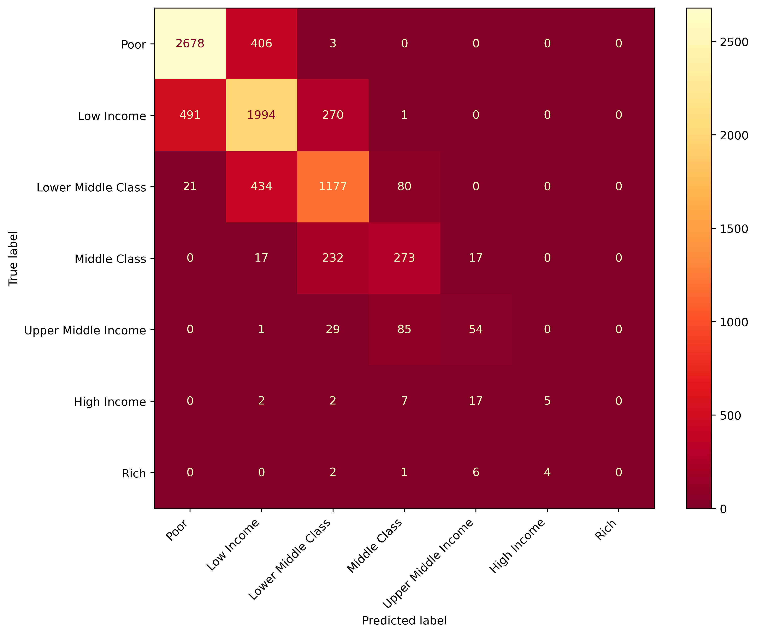
Prediction Model
The model fails to classify higher classes accurately!

Slide 17
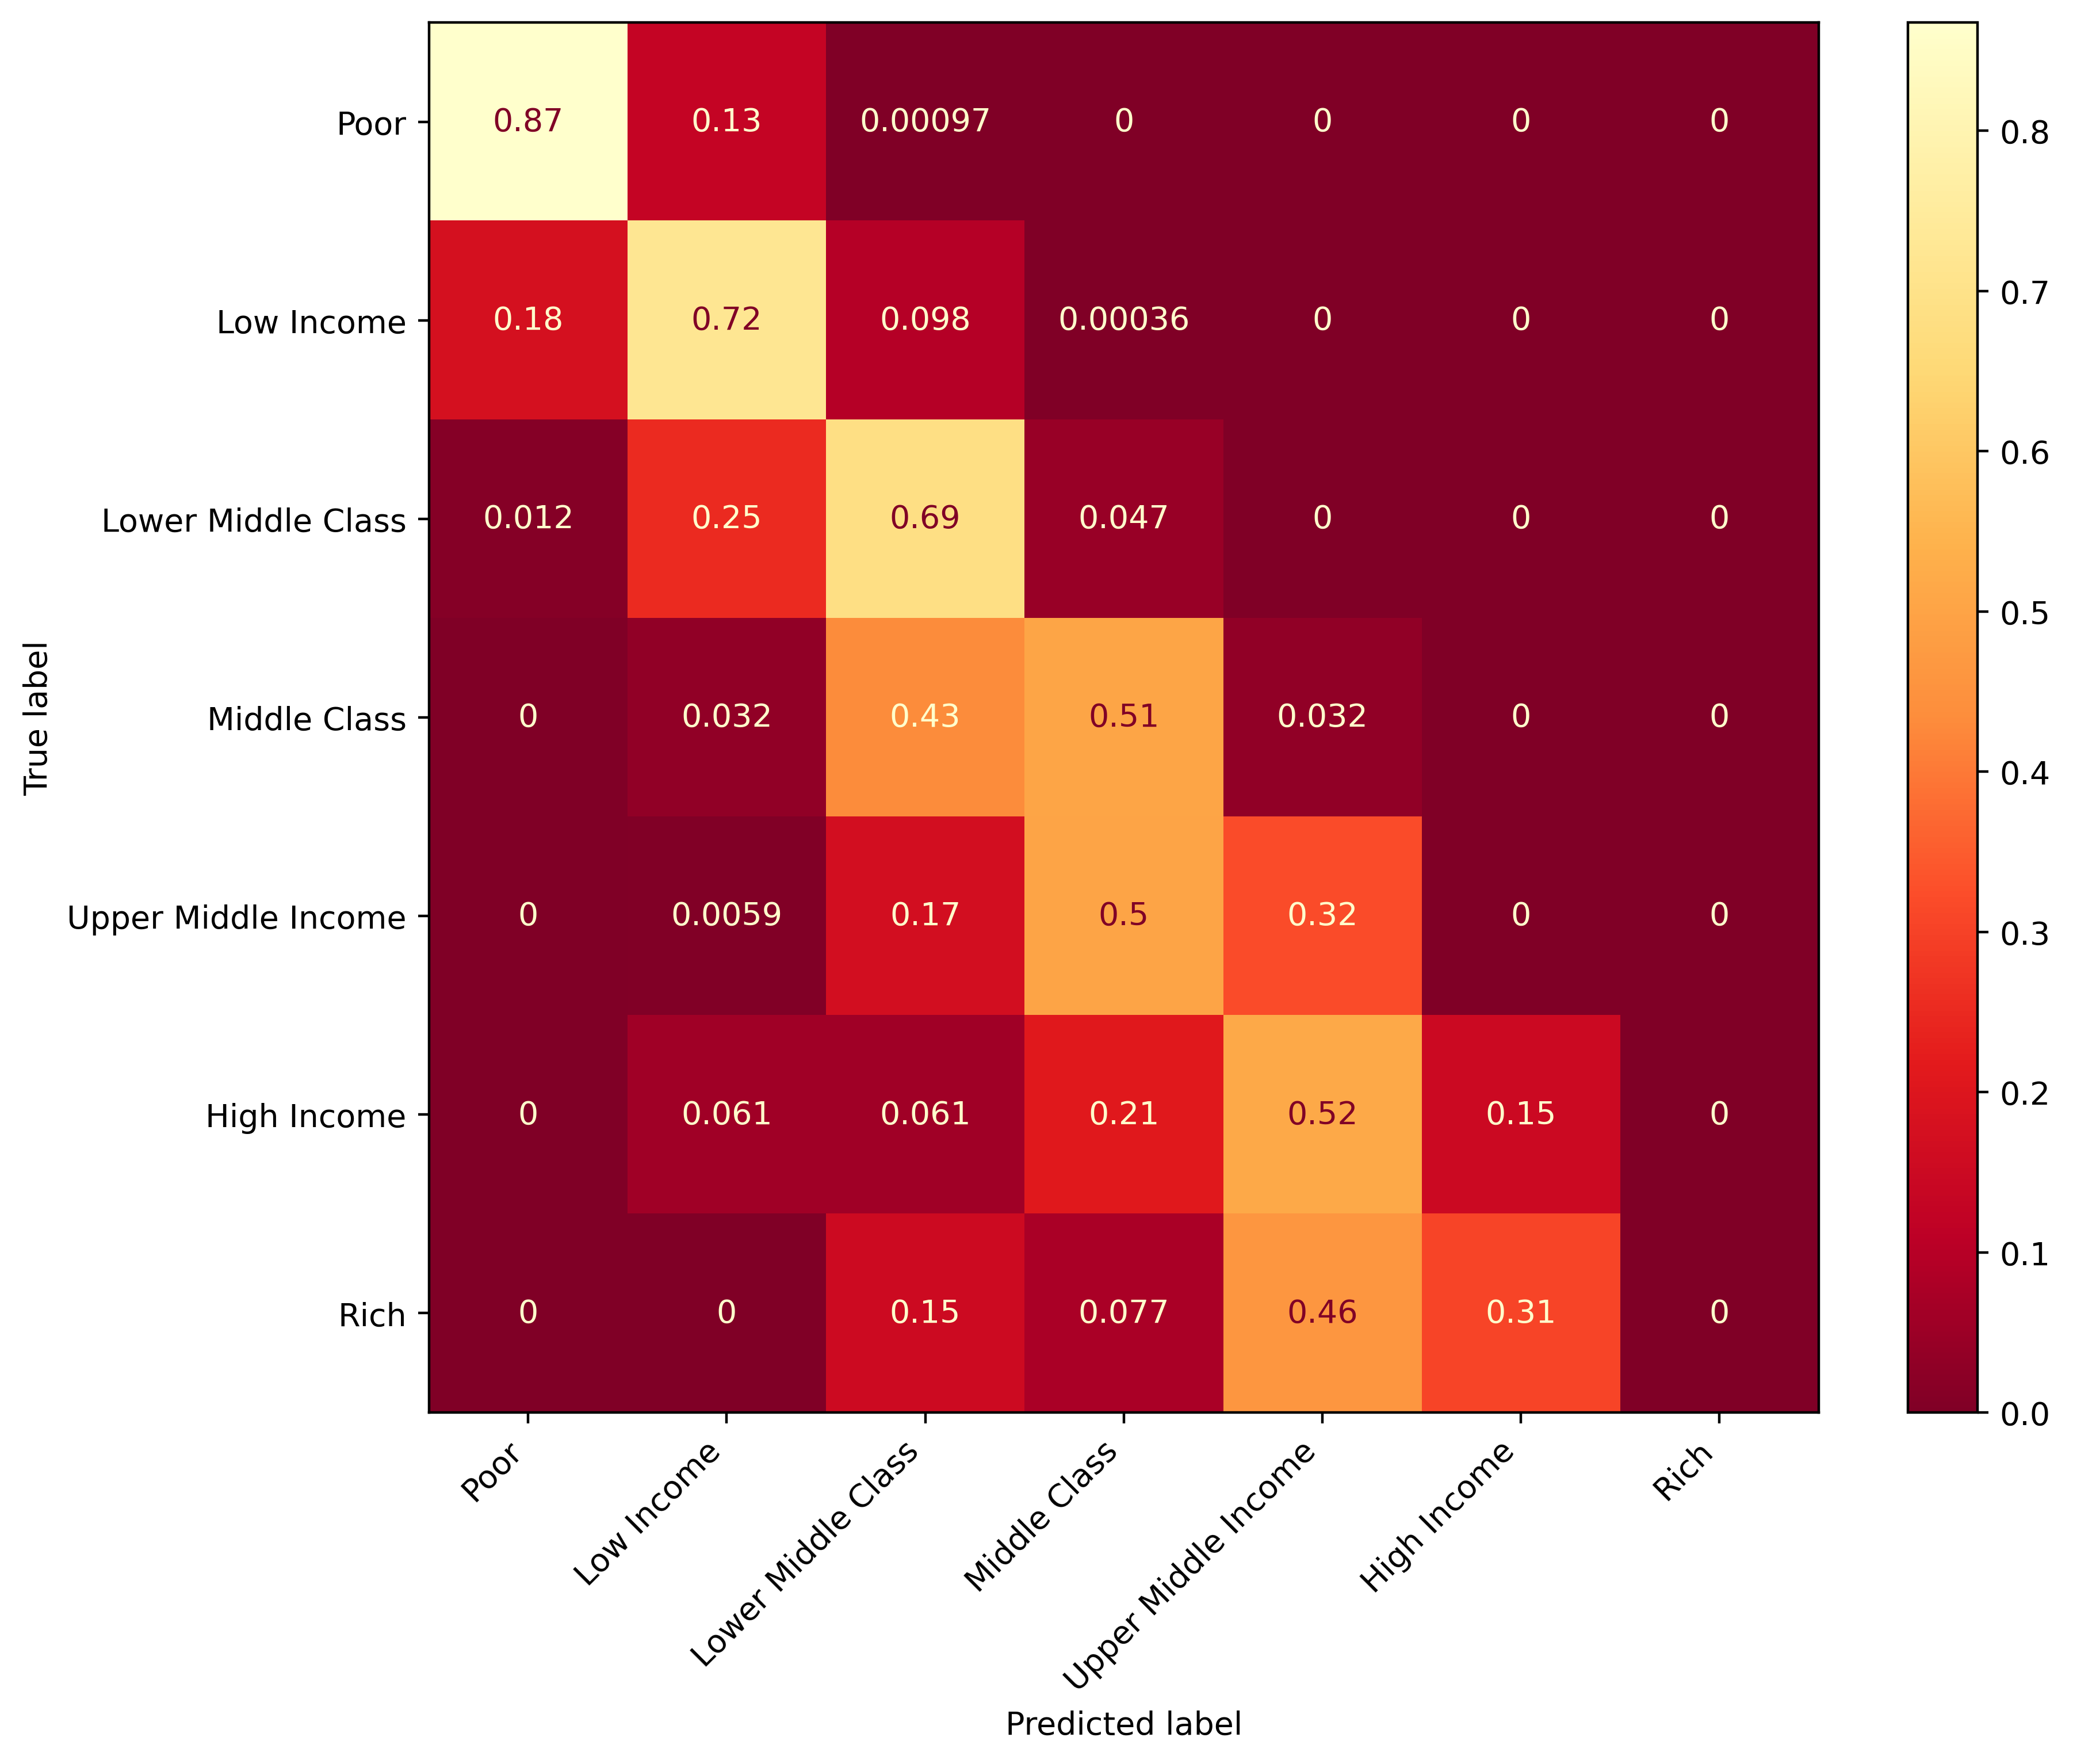
Prediction Model
The model fails to classify higher classes accurately!

Slide 18
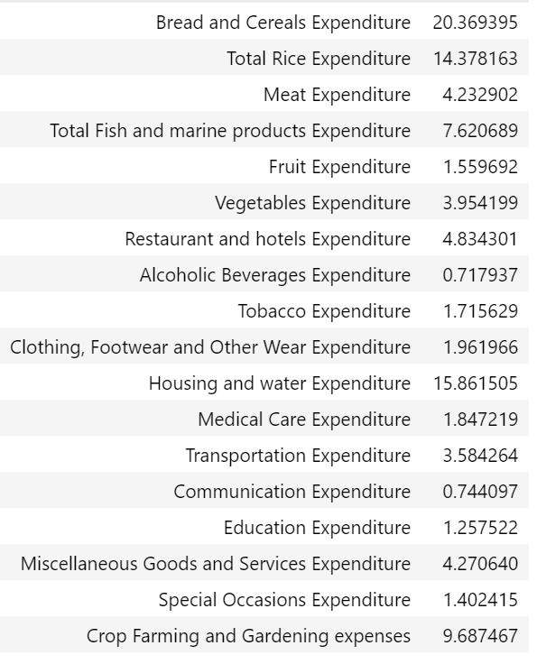
Synthesis
How does income inequality affect the spending behavior of different income classes?
Lower income classes have more constrained budget, forcing them to prioritize one expenditure more than the other.
Higher income classes have more freedom in budgeting.
This implies that expenditure proportions are sufficient determinants on the key areas to focus on in addressing the effects of income inequality on lower income classes.

Slide 19
End

Slide 20
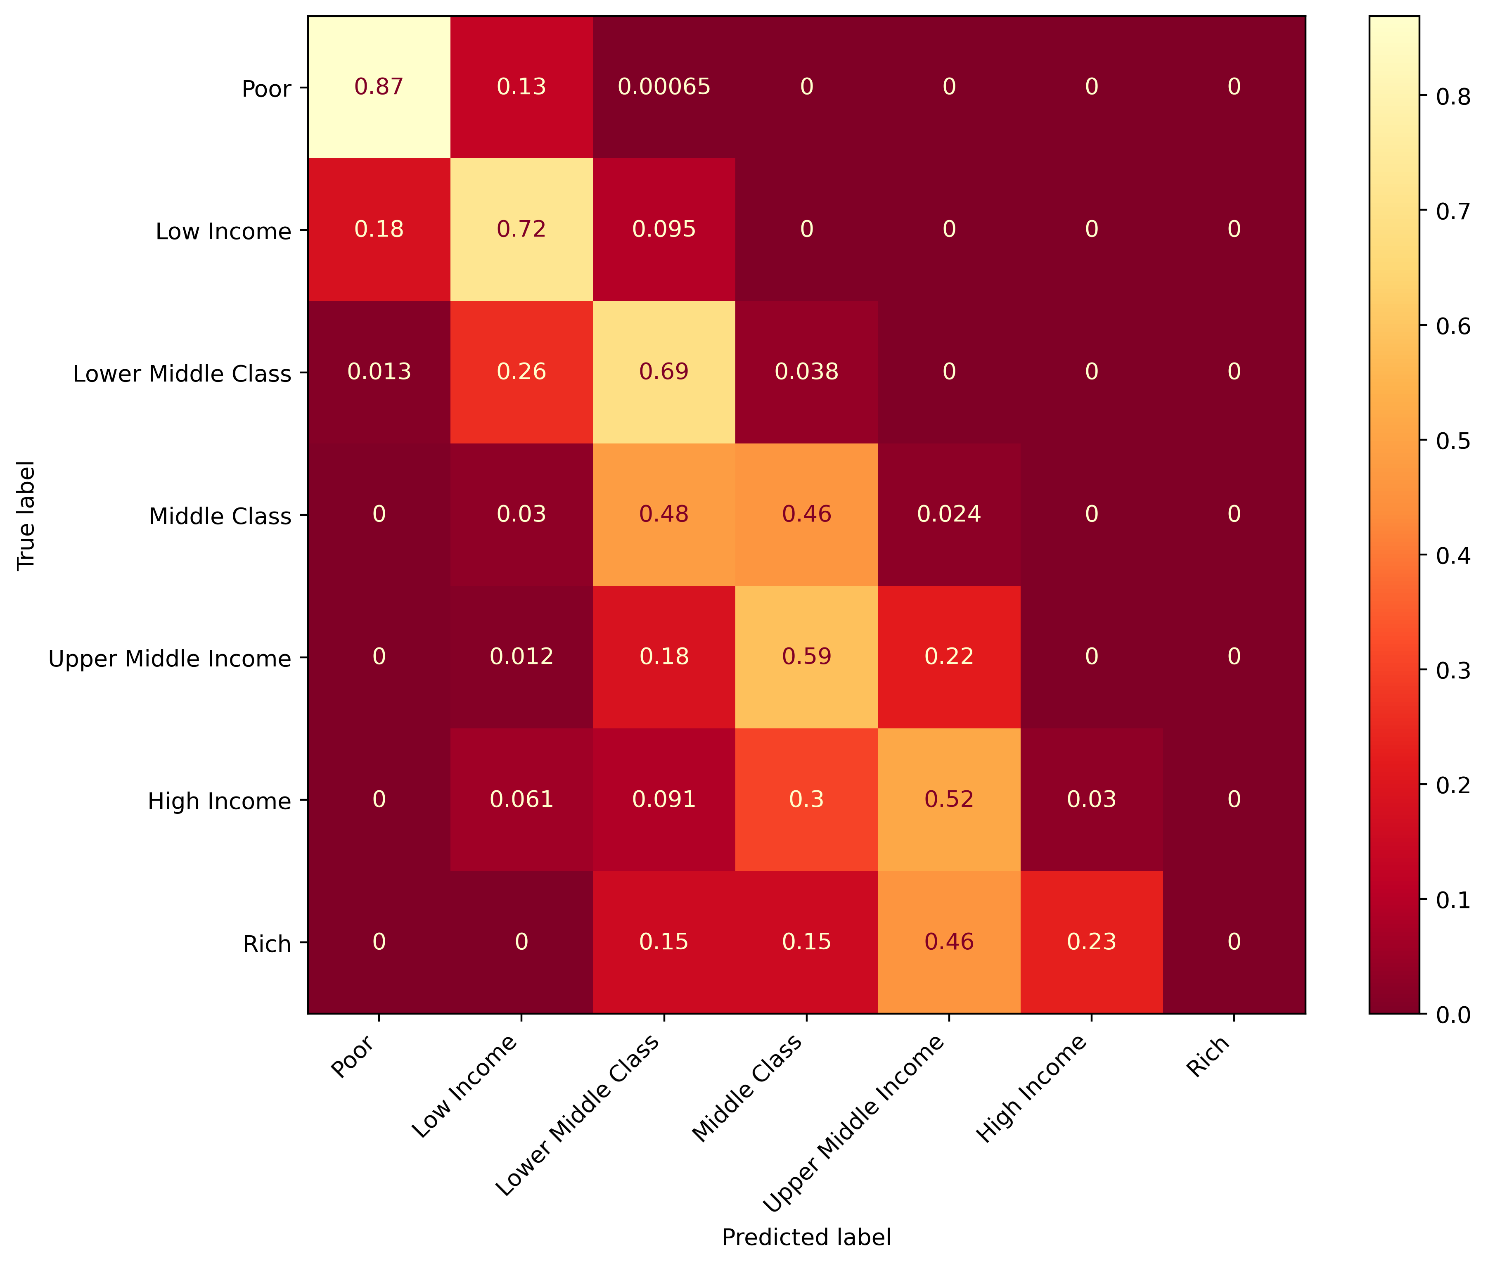
Region?
Accuracy: 73.93%

Slide 21
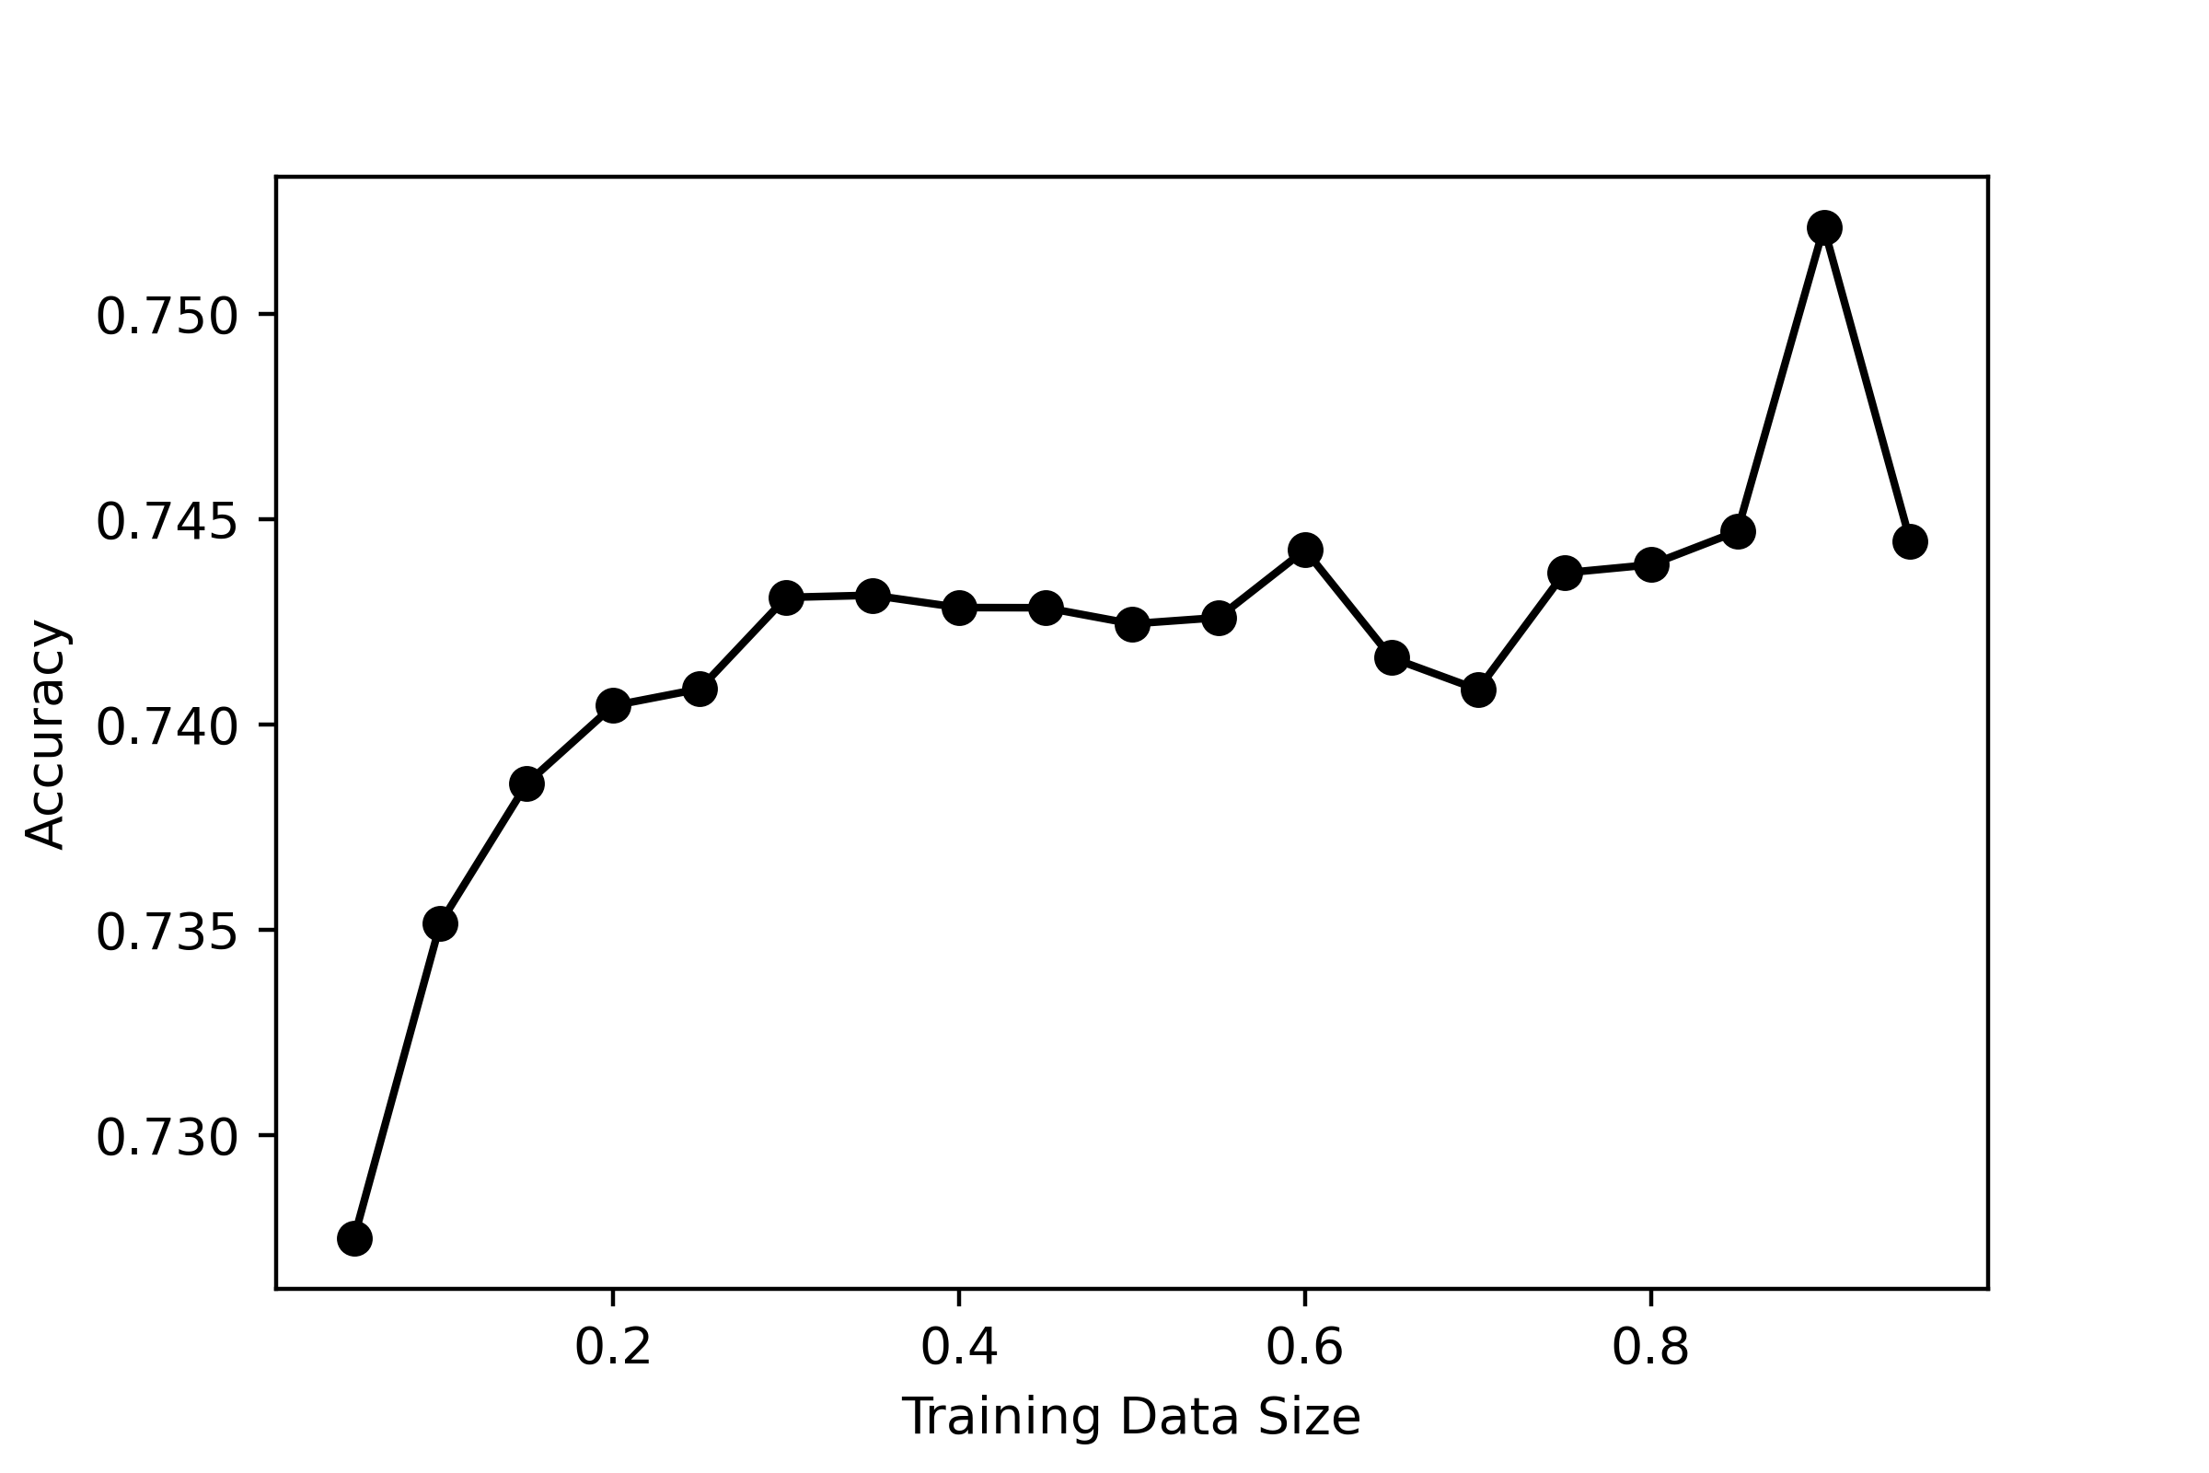
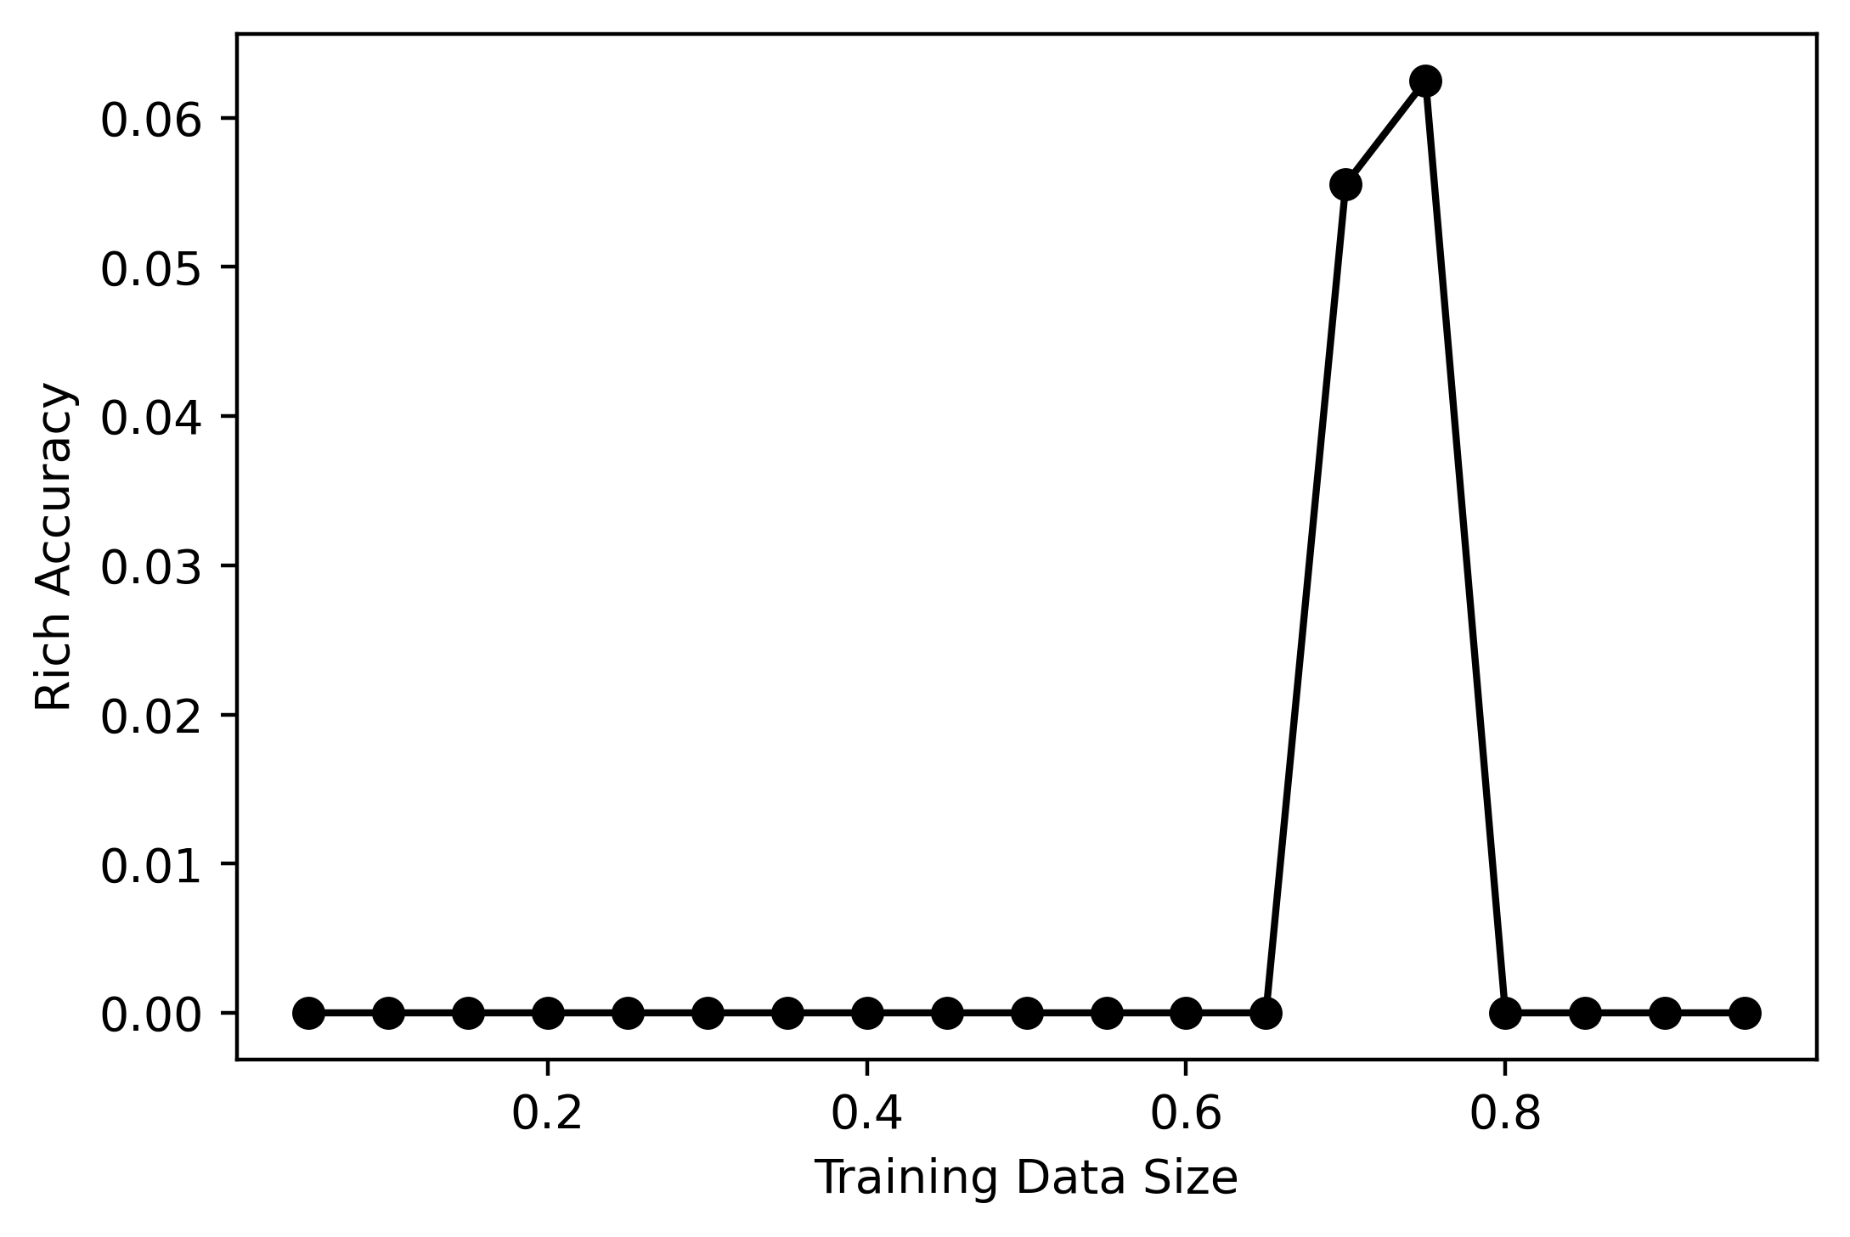
Different Training Data Size

